Slide 1
Wireless and Mobile Networks
Wireless, Mobile Networks
6-<number>

Slide 2
Wireless and Mobile Networks
Background:
# wireless (mobile) phone subscribers now exceeds # wired phone subscribers (5-to-1)!
# wireless Internet-connected devices equals # wireline Internet-connected devices
  laptops, Internet-enabled phones promise anytime untethered Internet access
two important (but different) challenges
  wireless: communication over wireless link
  mobility: handling the mobile user who changes point of attachment to network
Wireless, Mobile Networks
6-<number>

Slide 3



















Elements of a wireless network
network
infrastructure
Wireless, Mobile Networks
6-<number>

Slide 4



Elements of a wireless network
wireless hosts
laptop, smartphone
run applications
may be stationary (non-mobile) or mobile
  wireless does not always mean mobility
network
infrastructure
Wireless, Mobile Networks
6-<number>

Slide 5

Elements of a wireless network
base station
typically connected to wired network
relay - responsible for sending packets between wired network and wireless host(s) in its “area”
  e.g., cell towers, 802.11 access points
network
infrastructure
Wireless, Mobile Networks
6-<number>

Slide 6
Elements of a wireless network
wireless link
typically used to connect mobile(s) to base station
also used as backbone link
multiple access protocol coordinates link access
various data rates, transmission distance
network
infrastructure
Wireless, Mobile Networks
6-<number>

Slide 7
Characteristics of selected wireless links
200
802.11n
54
802.11a,g
802.11a,g point-to-point
5-11
802.11b
4G: LTWE WIMAX
4
3G: UMTS/WCDMA-HSPDA, CDMA2000-1xEVDO
Data rate (Mbps)
1
802.15
.384
2.5G: UMTS/WCDMA, CDMA2000
.056
2G: IS-95, CDMA, GSM
Indoor
10-30m
Outdoor
50-200m
Mid-range
outdoor
200m – 4 Km
Long-range
outdoor
5Km – 20 Km
Wireless, Mobile Networks
6-<number>

Slide 8
Elements of a wireless network
infrastructure mode
base station connects mobiles into wired network
handoff: mobile changes base station providing connection into wired network
network
infrastructure
Wireless, Mobile Networks
6-<number>

Slide 9


Elements of a wireless network
ad hoc mode
no base stations
nodes can only transmit to other nodes within link coverage
nodes organize themselves into a network: route among themselves
Wireless, Mobile Networks
6-<number>

Slide 10
Wireless network taxonomy
single hop
multiple hops
host connects to
base station (WiFi,
WiMAX, cellular)
which connects to
larger Internet
host may have to
relay through several
wireless nodes to
connect to larger
Internet: mesh net
infrastructure
(e.g., APs)
no base station, no
connection to larger
Internet. May have to
relay to reach other
a given wireless node
MANET, VANET
no
infrastructure
no base station, no
connection to larger
Internet (Bluetooth,
ad hoc nets)
Wireless, Mobile Networks
6-<number>

Slide 11
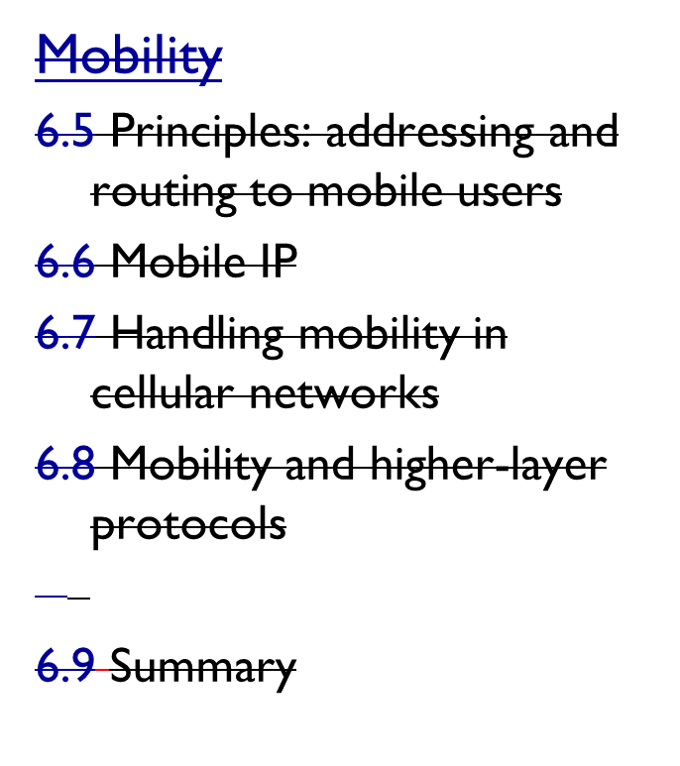
Chapter 6 outline
6.1 Introduction
Wireless
6.2 Wireless links, characteristics
  CDMA
6.3 IEEE 802.11 wireless LANs (“Wi-Fi”)
6.4 Cellular Internet Access
  architecture
  standards (e.g., GSM)
Wireless, Mobile Networks
6-<number>

Slide 12
Wireless Link Characteristics (1)
important differences from wired link ….
  decreased signal strength: radio signal attenuates as it propagates through matter (path loss)
  interference from other sources: standardized wireless network frequencies (e.g., 2.4 GHz) shared by other devices (e.g., phone); devices (motors) interfere as well
  multipath propagation: radio signal reflects off objects ground, arriving ad destination at slightly different times
…. make communication across (even a point to point) wireless link much more “difficult”
Wireless, Mobile Networks
6-<number>

Slide 13
Wireless Link Characteristics (2)
SNR: signal-to-noise ratio
  larger SNR – easier to extract signal from noise (a “good thing”)
SNR versus BER tradeoffs
  given physical layer: increase power -> increase SNR->decrease BER
  given SNR: choose physical layer that meets BER requirement, giving highest thruput
    SNR may change with mobility: dynamically adapt physical layer (modulation technique, rate)
10⁻¹
10⁻²
10⁻³
BER
10⁻⁴
10⁻⁵
10⁻⁶
10⁻⁷
10
20
30
40
SNR(dB)
QAM256 (8 Mbps)
QAM16 (4 Mbps)
BPSK (1 Mbps)
Wireless, Mobile Networks
6-<number>

Slide 14

Wireless network characteristics
Multiple wireless senders and receivers create additional problems (beyond multiple access):
A
B
C
C
A’s signal
strength
C’s signal
strength
B
A
Hidden terminal problem
B, A hear each other
B, C hear each other
A, C can not hear each other means A, C unaware of their interference at B
space
Signal attenuation:
B, A hear each other
B, C hear each other
A, C can not hear each other interfering at B
Wireless, Mobile Networks
6-<number>

Slide 15
Code Division Multiple Access (CDMA)
unique “code” assigned to each user; i.e., code set partitioning
  all users share same frequency, but each user has own “chipping” sequence (i.e., code) to encode data
  allows multiple users to “coexist” and transmit simultaneously with minimal interference (if codes are “orthogonal”)
encoded signal = (original data) X (chipping sequence)
decoding: inner-product of encoded signal and chipping sequence
Wireless, Mobile Networks
6-<number>

Slide 16
CDMA encode/decode
channel output Z_{i,m}
Z_{i,m}= d_{i}.c_{m}
data
bits
d₀ = 1
1
1
1
1
1
d₁ = -1
1
1
1
-
-
-
-
1
-
-
-
1
-
1
1
1
1
1
sender
1
1
slot 1
channel
output
slot 0
channel
output
1
1
1
1
1
code
1
1
-
-
-
1
-
1
1
1
-
-
-
1
-
1
1
1
slot 1
slot 0
M
D_{i} = Σ Z_{i,m}.c_{m}
m=1
M
received
input
1
1
1
1
1
1
1
1
d₀ = 1
-
-
-
-
1
-
-
-
1
-
1
1
1
1
1
1
d₁ = -1
1
slot 1
channel
output
slot 0
channel
output
1
1
1
1
1
code
1
1
-
-
-
1
-
1
1
1
-
-
-
1
-
1
1
1
receiver
slot 1
slot 0
Wireless, Mobile Networks
6-<number>

Slide 17

CDMA: two-sender interference
channel sums together transmissions by sender 1 and 2
Sender 1
Sender 2
using same code as sender 1, receiver recovers sender 1’s original data from summed channel data!
Wireless, Mobile Networks
6-<number>

Slide 18
Chapter 6 outline
6.1 Introduction
Wireless
6.2 Wireless links, characteristics
  CDMA
6.3 IEEE 802.11 wireless LANs (“Wi-Fi”)
6.4 Cellular Internet Access
  architecture
  standards (e.g., GSM)
Wireless, Mobile Networks
6-<number>

Slide 19
IEEE 802.11 Wireless LAN
802.11b
2.4-5 GHz unlicensed spectrum
up to 11 Mbps
direct sequence spread spectrum (DSSS) in physical layer
  all hosts use same chipping code
802.11a
  5-6 GHz range
  up to 54 Mbps
802.11g
  2.4-5 GHz range
  up to 54 Mbps
802.11n: multiple antennae
  2.4-5 GHz range
  up to 200 Mbps
all use CSMA/CA for multiple access
all have base-station and ad-hoc network versions
Wireless, Mobile Networks
6-<number>

Slide 20




802.11 LAN architecture
wireless host communicates with base station
  base station = access point (AP)
Basic Service Set (BSS) (aka “cell”) in infrastructure mode contains:
  wireless hosts
  access point (AP): base station
  ad hoc mode: hosts only
Internet
hub, switch
or router
BSS 1
BSS 2
Wireless, Mobile Networks
6-<number>

Slide 21
802.11: Channels, association
802.11b: 2.4GHz-2.485GHz spectrum divided into 11 channels at different frequencies
  AP admin chooses frequency for AP
  interference possible: channel can be same as that chosen by neighboring AP!
host: must associate with an AP
  scans channels, listening for beacon frames containing AP’s name (SSID) and MAC address
  selects AP to associate with
  may perform authentication [Chapter 8]
  will typically run DHCP to get IP address in AP’s subnet
Wireless, Mobile Networks
6-<number>

Slide 22
802.11: passive/active scanning
BBS 1
BBS 2
BBS 1
BBS 2
1
AP 2
AP 1
1
1
AP 2
AP 1
2
2
2
3
3
4
H1
H1
passive scanning:
beacon frames sent from APs
association Request frame sent: H1 to selected AP
association Response frame sent from selected AP to H1
active scanning:
Probe Request frame broadcast from H1
Probe Response frames sent from APs
Association Request frame sent: H1 to selected AP
Association Response frame sent from selected AP to H1
Wireless, Mobile Networks
6-<number>

Slide 23




IEEE 802.11: multiple access
avoid collisions: 2⁺ nodes transmitting at same time
802.11: CSMA - sense before transmitting
  don’t collide with ongoing transmission by other node
802.11: no collision detection!
  difficult to receive (sense collisions) when transmitting due to weak received signals (fading)
  can’t sense all collisions in any case: hidden terminal, fading
  goal: avoid collisions: CSMA/C(ollision)A(voidance)
A
B
C
C
B
A’s signal
strength
C’s signal
strength
A
space
Wireless, Mobile Networks
6-<number>

Slide 24
IEEE 802.11 MAC Protocol: CSMA/CA
802.11 sender
1 if sense channel idle for DIFS then
  transmit entire frame (no CD)
2 if sense channel busy then
  start random backoff time
  timer counts down while channel idle
  transmit when timer expires
  if no ACK, increase random backoff interval, repeat 2
802.11 receiver
- if frame received OK
return ACK after SIFS (ACK needed due to hidden terminal problem)
sender
receiver
DIFS
data
SIFS
ACK
Wireless, Mobile Networks
6-<number>

Slide 25
Avoiding collisions (more)
idea: allow sender to “reserve” channel rather than random access of data frames: avoid collisions of long data frames
sender first transmits small request-to-send (RTS) packets to BS using CSMA
  RTSs may still collide with each other (but they’re short)
BS broadcasts clear-to-send CTS in response to RTS
CTS heard by all nodes
  sender transmits data frame
  other stations defer transmissions
avoid data frame collisions completely
using small reservation packets!
Wireless, Mobile Networks
6-<number>

Slide 26

Collision Avoidance: RTS-CTS exchange
A
B
AP
RTS(B)
RTS(A)
reservation collision
RTS(A)
CTS(A)
CTS(A)
DATA (A)
defer
time
ACK(A)
ACK(A)
Wireless, Mobile Networks
6-<number>

Slide 27
802.11 frame: addressing
2
2
6
6
6
2
6
0 - 2312
4
frame
control
duration
address
1
address
2
address
3
seq
control
address
4
payload
CRC
Address 4: used only in ad hoc mode
Address 1: MAC address
of wireless host or AP
to receive this frame
Address 3: MAC address
of router interface to which AP is attached
Address 2: MAC address
of wireless host or AP
transmitting this frame
Wireless, Mobile Networks
6-<number>

Slide 28
802.11 frame: addressing
Internet
H1
R1
router
R1 MAC addr H1 MAC addr
dest. address
source address
802.3 frame
AP MAC addr H1 MAC addr R1 MAC addr
address 1
address 2
address 3
802.11 frame
Wireless, Mobile Networks
6-<number>

Slide 29
802.11 frame: more
frame seq #
(for RDT)
duration of reserved
transmission time (RTS/CTS)
2
2
6
6
6
2
6
0 - 2312
4
frame
control
duration
address
1
address
2
address
3
seq
control
address
4
payload
CRC
2
2
4
1
1
1
1
1
1
1
1
Protocol
version
Type
Subtype
To
AP
From
AP
More
frag
Retry
Power
mgt
More
data
WEP
Rsvd
frame type
(RTS, CTS, ACK, data)
Wireless, Mobile Networks
6-<number>

Slide 30

802.11: mobility within same subnet
H1 remains in same IP subnet: IP address can remain same
switch: which AP is associated with H1?
  self-learning (Ch. 5): switch will see frame from H1 and “remember” which switch port can be used to reach H1
BBS 1
H1
BBS 2
Wireless, Mobile Networks
6-<number>

Slide 31
802.11: advanced capabilities
Rate adaptation
base station, mobile dynamically change transmission rate (physical layer modulation technique) as mobile moves, SNR varies
10⁻¹
10⁻²
10⁻³
BER
10⁻⁴
10⁻⁵
10⁻⁶
10⁻⁷
10
20
30
40
SNR(dB)
1. SNR decreases, BER increase as node moves away from base station
QAM256 (8 Mbps)
QAM16 (4 Mbps)
2. When BER becomes too high, switch to lower transmission rate but with lower BER
BPSK (1 Mbps)
operating point
Wireless, Mobile Networks
6-<number>

Slide 32
802.11: advanced capabilities
power management
node-to-AP: “I am going to sleep until next beacon frame”
  AP knows not to transmit frames to this node
  node wakes up before next beacon frame
beacon frame: contains list of mobiles with AP-to-mobile frames waiting to be sent
  node will stay awake if AP-to-mobile frames to be sent; otherwise sleep again until next beacon frame
Wireless, Mobile Networks
6-<number>

Slide 33
802.15: personal area network
less than 10 m diameter
replacement for cables (mouse, keyboard, headphones)
ad hoc: no infrastructure
master/slaves:
  slaves request permission to send (to master)
  master grants requests
802.15: evolved from Bluetooth specification
  2.4-2.5 GHz radio band
  up to 721 kbps
S
P
P
radius of
coverage
M
S
S
P
P
M
Master device
Slave device
Parked device (inactive)
S
P
Wireless, Mobile Networks
6-<number>

Slide 34
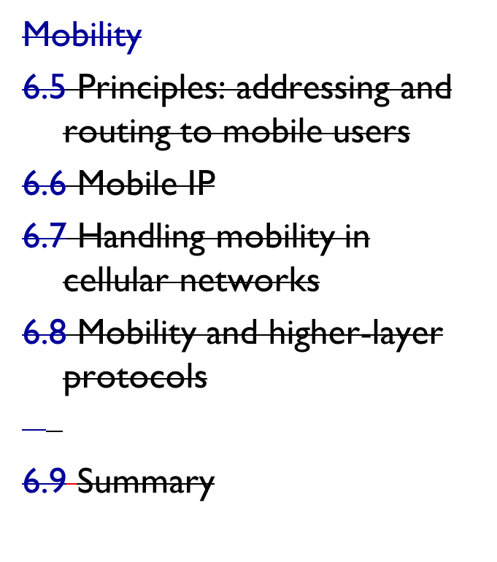
Chapter 6 outline
6.1 Introduction
Wireless
6.2 Wireless links, characteristics
  CDMA
6.3 IEEE 802.11 wireless LANs (“Wi-Fi”)
6.4 Cellular Internet access
  architecture
  standards (e.g., GSM)
Wireless, Mobile Networks
6-<number>

Slide 35


Components of cellular network architecture
MSC
connects cells to wired tel. net.
manages call setup (more later!)
handles mobility (more later!)
cell
covers geographical region
base station (BS) analogous to 802.11 AP
mobile users attach to network through BS
air-interface: physical and link layer protocol between mobile and BS
Mobile
Switching
Center
Public telephone
network
Mobile
Switching
Center
wired network
Wireless, Mobile Networks
6-<number>

Slide 36
Cellular networks: the first hop
Two techniques for sharing mobile-to-BS radio spectrum
combined FDMA/TDMA: divide spectrum in frequency channels, divide each channel into time slots
CDMA: code division multiple access
time slots
frequency
bands
Wireless, Mobile Networks
6-<number>

Slide 37
2G (voice) network architecture
Base station system (BSS)
MSC
BTS
BSC
G
Public
telephone
network
Gateway
MSC
Legend
Base transceiver station (BTS)
Base station controller (BSC)
Mobile Switching Center (MSC)
Mobile subscribers
Wireless, Mobile Networks
6-<number>

Slide 38
3G (voice+data) network architecture
MSC
G
Public
telephone
network
radio
network
controller
Gateway
MSC
G
Public
Internet
SGSN
Key insight: new cellular data
network operates in parallel
(except at edge) with existing
cellular voice network
voice network unchanged in core
data network operates in parallel
GGSN
Serving GPRS Support Node (SGSN)
Gateway GPRS Support Node (GGSN)
Wireless, Mobile Networks
6-<number>

Slide 39
3G (voice+data) network architecture
MSC
G
Public
telephone
network
radio
network
controller
Gateway
MSC
G
Public
Internet
SGSN
GGSN
radio interface
(WCDMA, HSPA)
radio access network
Universal Terrestrial Radio
Access Network (UTRAN)
core network
General Packet Radio Service
(GPRS) Core Network
public
Internet
Wireless, Mobile Networks
6-<number>

Slide 40
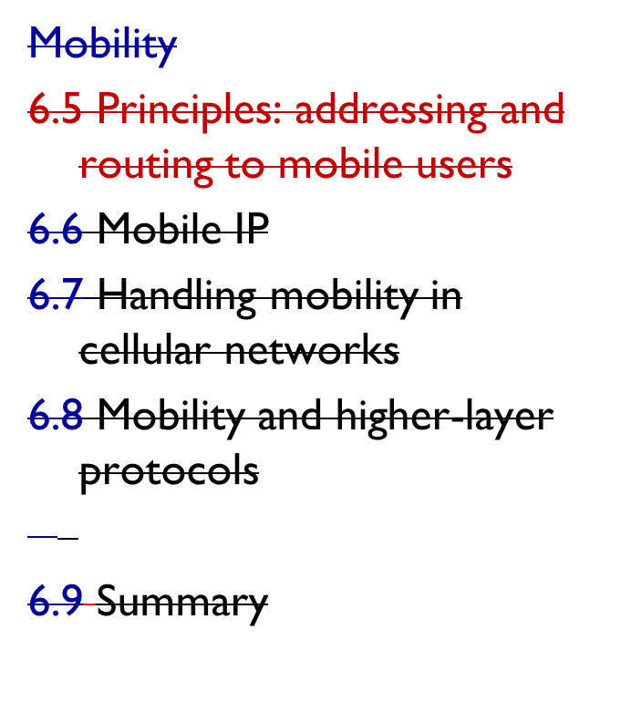
Chapter 6 outline
6.1 Introduction
Wireless
6.2 Wireless links, characteristics
  CDMA
6.3 IEEE 802.11 wireless LANs (“Wi-Fi”)
6.4 Cellular Internet Access
  architecture
  standards (e.g., GSM)
Wireless, Mobile Networks
6-<number>

